Slide 1
Artificial Intelligence
CS-451
Instructor: Dr Syed Musharaf Ali

Slide 2
Artificial Intelligence Approach
Agents and Environments:
AI approach is called intelligent agent
An agent is anything that can perceive its environment through sensors and acts upon that environment through effectors.
A function of an agent that maps sensors to effectors is called Control-Policy of the agent.
Notes:
Effector: something that respond to signal/stimulus/information

Slide 3
Artificial Intelligence Approach
Agents and Environments:
Sensors
Agent
Enviroment
Effectors
Perception-Action Cycle
Notes:
Effector: something that respond to signal/stimulus/information

Slide 4
Intelligent Agent
An agent is anything that can be viewed as perceiving its environment through sensors and acting upon that environment through effectors
A rational agent is one that does the right action. The right action is the one that will cause the agent to be the most successful.
Performance measure is the criteria that determine how successful an agent is e.g. % accuracy achieved, amount of work done, energy consumed, time in seconds etc.
Notes:
Rational : based on reason and logic

Slide 5
Intelligent Agent
An ideal rational agent:
For each possible percept sequence, an ideal rational agent should do whatever action is expected to maximize its performance measure, on the basis of the evidence(information) provided by the percept sequence and whatever built-in knowledge the agent has.

Slide 6
Intelligent Agent
Mapping:
An agent’s behaviour depends only on its percept sequence
We can describe any particular agent by making a table of the action it takes in response to each possible percept sequence.
Percept
Sequence
Action
P1
P2
P3
A1
A2
A3
Mapping from percept sequnce to actions

Slide 7
Intelligent Agent
Autonomy:
A system is autonomous, if it’s behaviour is determined by its own experience and learning
If the agent’s actions are based completely on built-in knowledge, then we say that the agent lacks autonomy.
It would be reasonable to provide an artificial agent with some built-in knowledge as well as ability to learn.
A truly autonomous intelligent agent should be able to operate successfully in a wide variety of environments, given sufficient time to adapt

Slide 8
Agent Program
Agent program: A function that implements the agent mapping from precepts to actions.
Computing device on which program will run, we call architecture
The architecture makes the percepts from the sensors available to the program, run the program, and feeds the program’s action to the effectors.
Agent = architecture + program

Slide 9
Agent Program
Designing agent program, we need to keep in mind
Possible percepts and actions
Performance measures (Goals)
What sort of environment it will operate
Agent type | Percepts | Actions | Goals | Enviroments
Taxi driver (self driving car) | Cameras, speedometer, GPS, sonar, microphone etc | Steer, accelarate, brake, talk to passenger | Safe, fast, legal, comfortable trip, maximize profits | Roads, traffic, pedestrians, customers

Slide 10
Environments
Environment provides percepts/information to the agent, and agent done actions on the environment

Slide 11
Properties of Environments
Fully observable vs. partially observable:
If an agent's sensors give it access to the complete state of the environment at each point in time then we say that the environment is fully observable/accessible to that agent e.g.
Game of chess (fully observable)
Poker, self driving car (partially observable)

Slide 12
Properties of Environments
Deterministic vs. nondeterministic:
If the next state of the environment is completely determined by the current state and the actions selected by the agent, then we say environment is deterministic e.g.
Chess (deterministic)
Dice, poker, taxi driver (non deterministic)
If environment is fully observable and deterministic then agent need not to worry about uncertainty

Slide 13
Properties of Environments
Episodic vs. non episodic:
The agent's experience is divided into atomic "episodes" (each episode consists of the agent perceiving and then performing a single action), and the quality of action in each episode depends only on the episode itself.
Subsequent episodes do not depend on what actions occur in previous episodes e.g.
Part-picking robot (Episodic)
Chess, poker, Taxi driving (nonepisodic)

Slide 14
Properties of Environments
Static vs. dynamic:
The environment can change while an agent is deliberating then we say the environment is dynamic for that agent otherwise it is static e.g.
Chess (static)
Taxi driving (dynamic)

Slide 15
Properties of Environments
Discrete (vs. continuous):
A limited number of distinct, clearly defined percepts and actions , we say that environment is discrete e.g.
Chess (discrete)… there are fixed number of possible moves on each turn
Driving (continuous)

Slide 16
Properties of Environments
Different environment types require different agent programs to deal with them effectively.
Environment that is partially observable, non episodic, dynamic and continuous is hardest for artificial intelligent agent to deal with.

Slide 17
Agent Program
Types of agents are
Simple reflex agents
Model-based reflex agents
Goal-based agents
Utility-based agents
Learning agents

Slide 18
Simple Reflex Agents
They choose actions only based on the current percept.
They are rational only if a correct decision is made only on the basis of current precept.
Their environment is completely observable.
Condition-Action Rule − It is a rule that maps a state (condition) to an action.

Slide 19
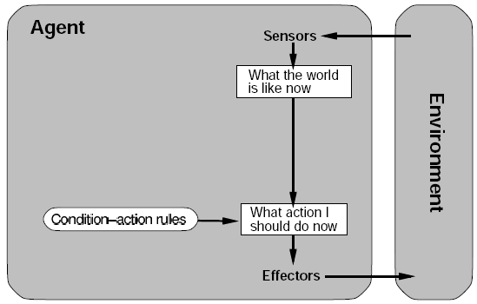
Simple Reflex Agents
This agent function only succeeds when the environment is fully observable
e.g. If the car-in-front is braking then initiate braking.
If hand is in fire then pull away hand
If there is a rock then pick it up (Mars lander)

Slide 20
Model-based Reflex Agents
Model-based reflex agents are made to deal with partial accessibility
They use a model of the world to choose their actions. They maintain an internal state.
Model − The knowledge about how the things happen in the world.
Internal State − It is a representation of unobserved aspects of current state depending on percept history.
Updating the state requires the information about −
How the world evolves.
How the agent’s actions affect the world.

Slide 21
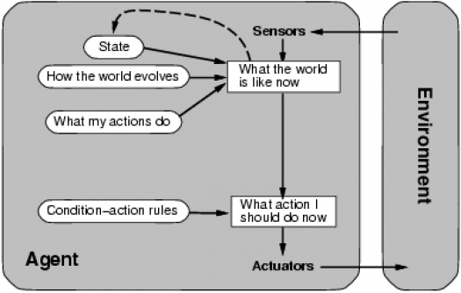
Model-based Reflex Agents
e.g. This time out mars Lander after picking up its first sample, it stores this in the internal state of the world around it so when it come across the second same sample it passes it by and saves space for other samples.

Slide 22
Goal-based Reflex Agents
Goal-based agents further expand on the capabilities of the model-based agents, by using "goal" information.
Goal information describes situations that are desirable.
This allows the agent a way to choose among multiple possibilities/actions, selecting the one which reaches a goal state.
Search and planning are the subfields of artificial intelligence devoted to finding action sequences that achieve the agent's goals.

Slide 23
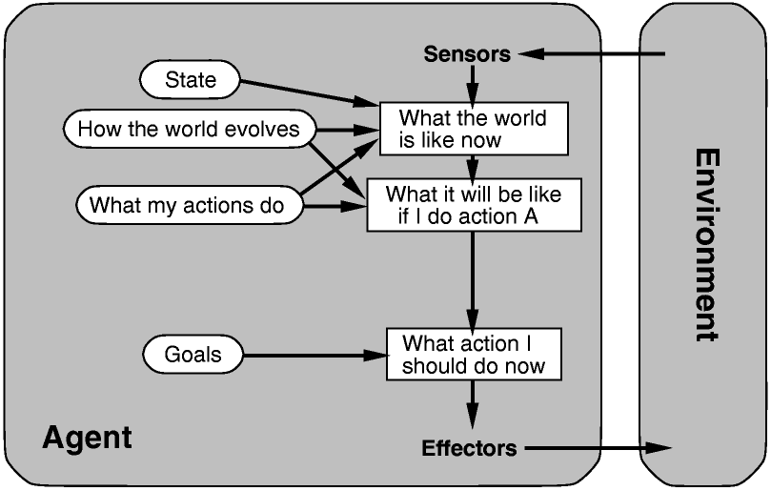
Goals-based Reflex Agents

Slide 24
Utility-based Reflex Agents
Just having goals isn’t good enough because often we may have several actions which all satisfy our goal so we need some way of working out the most efficient one.
A utility function maps each state after each action to a real number representing how efficiently each action achieves the goal.
This is useful when we either have many actions all solving the same goal

Slide 25
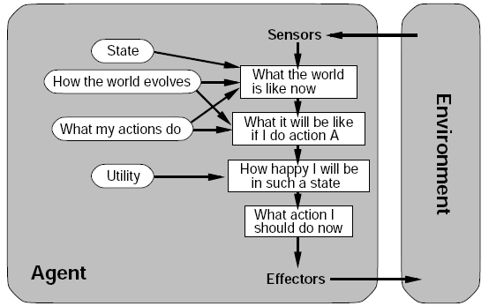
Utility-based Reflex Agents
e.g. Shortest path finding algorithm.

Slide 26
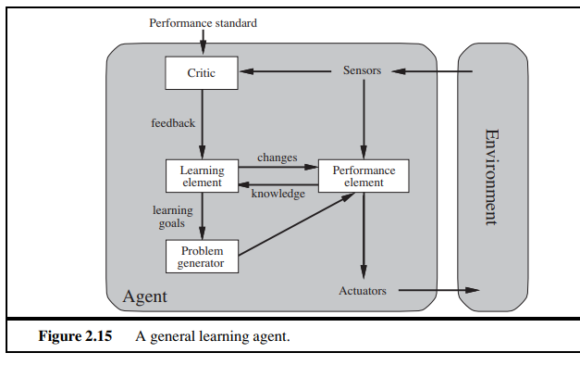
Learning Agents

Slide 27
Learning Agents
A learning agent can be divided into four conceptual components,
Learning element, which is responsible for making improvements
Performance element select actions. The performance element is what we have previously considered to be the entire agent: it takes in percepts and decides on actions.
The learning element uses CRITIC feedback from the critic on how the agent is doing and determines how the performance element should be modified to do better in the future
Problem generator is responsible for suggesting actions that will lead to new and informative experiences

